Slide 1
Take five
Database series

Slide 2
Take five database series
Loading Data into a Postgres Table
Dr. William Sewell

Slide 3
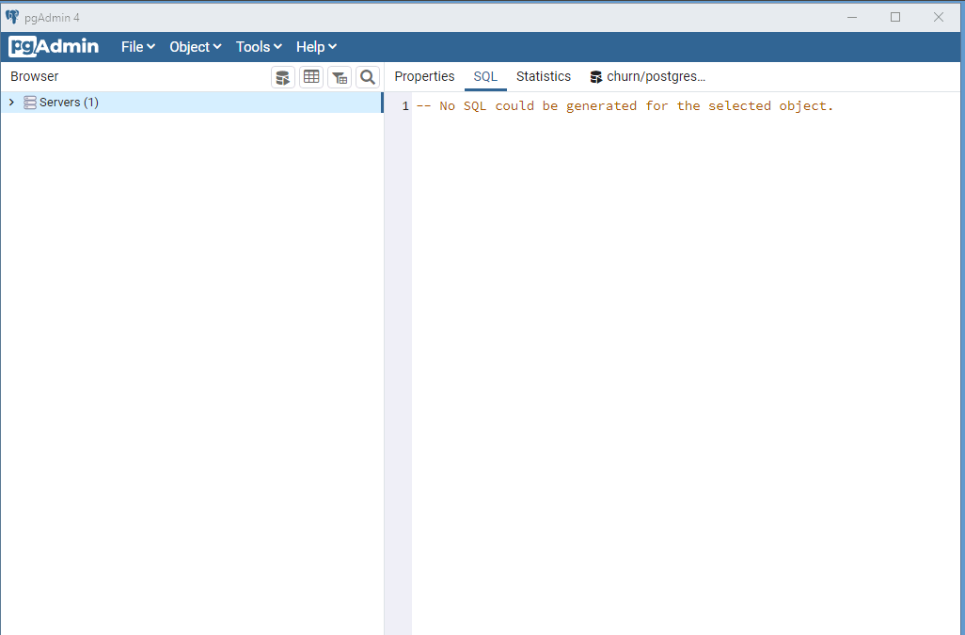
In PgAdmin, you
Can navigate by
Clicking the > sign
And expanding the
List of items.
In the next slide,
You will see the
Expanded list down
To the tables in the
Churn database.

Slide 4
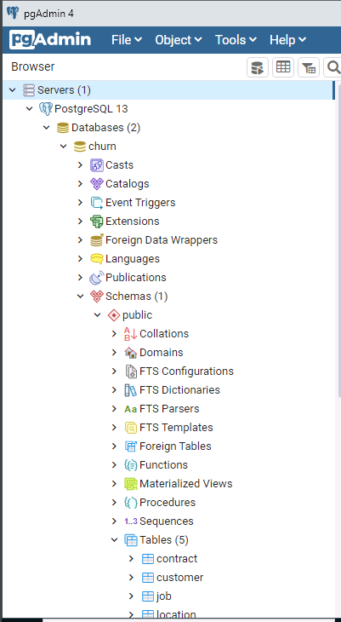
In this slide, the list of database
Items has been expanded by
Clicking the > sign for Servers|
PostgreSQL 13| Databases|Churn|
Tables.
Here are the five base tables
In Churn →

Slide 5
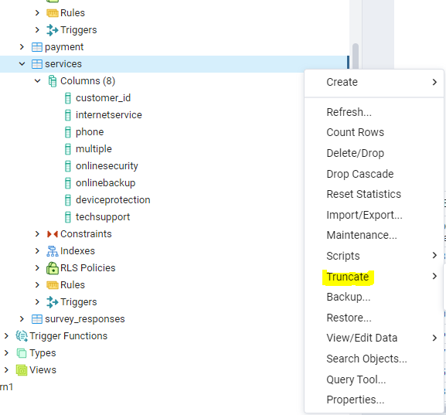
Suppose you have
a table with data
that you want to refresh.
Let’s say that the refresh
will contain all the data
past and present.
In that case, you will
first want to truncate
the table Table to
remove all the rows.
Right-click on the table
and select truncate.
Truncate keeps the
table and indexes
Intact.

Slide 6
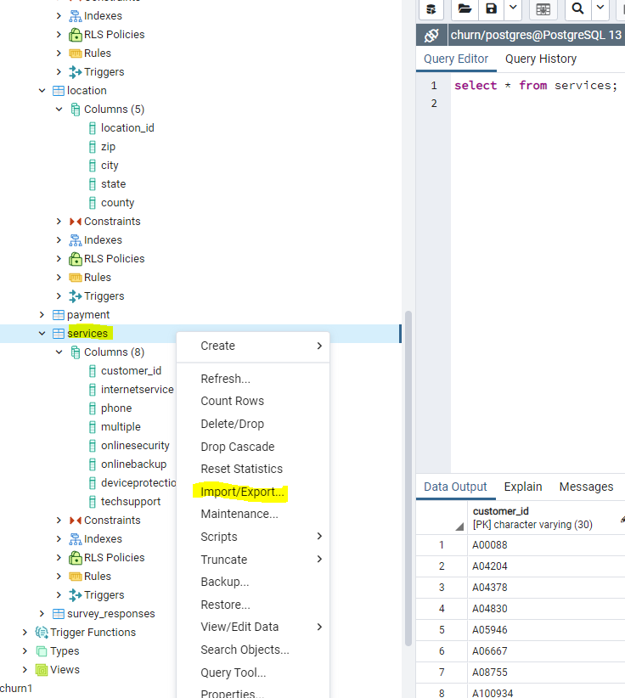
Once you have an empty
table, right-click on it and
select Import/Export from
the menu.

Slide 7
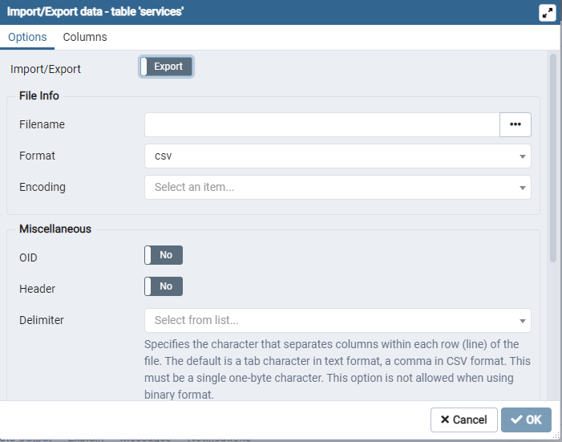
Notice that the default
Is Export. Click on it
To toggle to Import.
If not, you will overwrite
Your existing file.
Next, click the ellipses to
Navigate to your file.
The format defaults to
CSV.
Click the Header to
Toggle to “Yes”.
Use the dropdown to
Select your delimiter.
Then click “Ok”

Slide 8
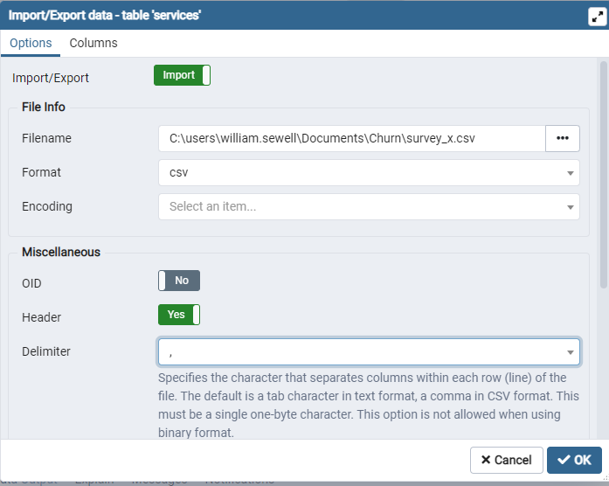
Here is what your Import
Dialog box should look like
When it is set to Import.

Slide 9
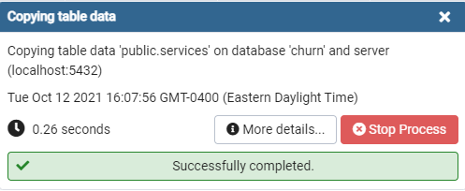
The Copy Dialog box will appear.
Click More Details to see the
Command that pgAdmin ran
In the background.

Slide 10
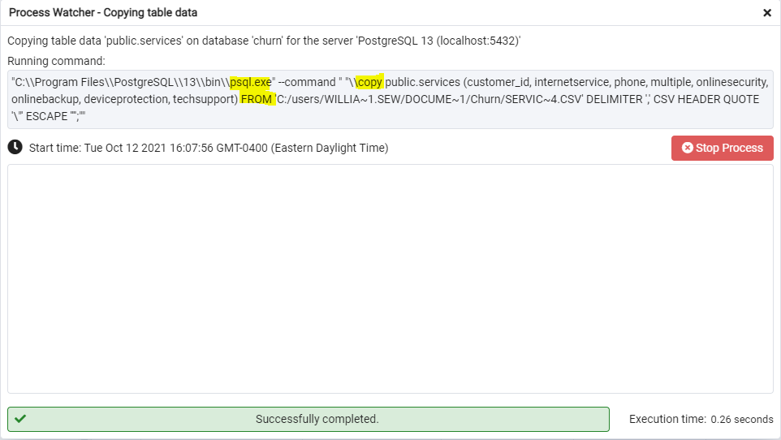

Slide 11
Take five database series
Loading Data into a Postgres Table
Dr. William Sewell

